Slide 1
Engineering Management Principles and Economics ENGR 301
Lecture 10
Depreciation
Dr C.J. Willis, CAPM, P.Eng
‹#›

Slide 2
Learning Objectives
Understand what is income
Understand the concepts of Depreciation, Deterioration, and Obsolescence
Understand the types of depreciable property
Understand the types of depreciation methods
Dr C.J. Willis, CAPM, P.Eng
‹#›

Slide 3
Income
The measure of a business’s success is its annual profit or loss.
More simply:
Income = Revenue – Costs to obtain revenue
Revenue is money coming in
Derived from sales of products
Costs are money going out to obtain the resources to generate revenue
Labour costs, material costs, administration costs
We can easily compare revenues for a year with the costs that occurred within that year
Dr C.J. Willis, CAPM, P.Eng
‹#›

Slide 4
Income
There is, however, a group of items called physical assets, which are obtained and typically lose value over time.
Physical capital assets (buildings, equipment, machinery) last for longer than a year and are usually paid for at the time they are obtained.
Therefore, to represent their contribution to the annual income, some method must be used to allocate the cost of these assets over their useful lives.
Depreciation is the mechanism for allocating the cost of a long-lived property over a number of years for the purpose of calculating annual income.
Dr C.J. Willis, CAPM, P.Eng
‹#›
Notes:
‹#›

Slide 5
Depreciation
Defined as:
Decrease in value (three distinct possibilities):
Decline in market value
Decline in value to an owner
Systematic allocation of the cost of an asset over its depreciable life (accountant’s definition)
A machine may decrease in value because it is deteriorating or wearing out.
Depreciation is also caused by obsolescence.
When it is no longer useful or needed
Dr C.J. Willis, CAPM, P.Eng
‹#›
Notes:
Revenue is straight forward and is derived from sales of the products
Costs are: labour costs, material costs, administration costs (office rental) etc.
We can easily compare revenues for a year with the costs that occurred within that year.
Physical capital assets (buildings, equipment, machinery) last for longer than a year and are usually paid for at the time they are obtained. Therefore, to represent their contribution to the annual income, some method must be used to allocate the cost of these assets over their useful lives.
Depreciation is the mechanism for allocating the cost of a long-lived property over a number of years for the purpose of calculating annual income.
Depreciation rules determine the time it will take firms to recover their capital investments
‹#›

Slide 6
Depreciation versus Expenses
Business costs are either expensed or depreciated
Expenses are consumed over the normal course of business and over a short period of time.
Labour, materials, insurance, etc.
In contrast, capital assets are not fully written off when they occur.
They are depreciated over an extended period of time because they have a depreciable life.
Buildings, large machines, vehicles, computers, etc.
Dr C.J. Willis, CAPM, P.Eng
‹#›
Notes:
Market value refers to the monetary value others place on property
It is the accountant’s definition that is used to compute depreciation for business assets
A machine may depreciate because it is deteriorating. (think of your car, the parts deteriorate over time)
Alternatively, a machine may depreciate because it becomes obsolete. Think of an early computer, mechanical calculator, a walkman, a cassette.
‹#›

Slide 7
Depreciation
Depreciation is a non-cash cost (no actual exchange of dollars).
Depreciation is a way to claim business expenses over time.
To be depreciable, assets must:
Be used for business purposes to produce income
Have a useful life that can be determined and that is longer than one year
Be an asset that decays, gets used up, wears out, becomes obsolete, or loses value to the owner from natural causes
Dr C.J. Willis, CAPM, P.Eng
‹#›
Notes:
Expenses are usually recurring
The cost of expensed items do not loose value gradually. For tax purposes they are subtracted from the business revenues when they occur. Expensed costs reduce income taxes
Business costs due to capital assets are not fully written off when they occur. A capital asset loses value gradually and must be written off or depreciated over an extended period of time
Depreciable life: determined by the depreciation method used to spread out the cost. Many types of depreciable assets operate well beyond their depreciable life.
‹#›

Slide 8
Types of Property
The rules of depreciation are linked to the classification of business property as either tangible or intangible. Tangible property is further classified as real or personal.
Tangible Property
Can be seen, touched, and felt
Real Property
Land, buildings, and all things growing on, built upon, constructed on, or attached to the land
Personal Property
Equipment, furnishings, vehicles, and any other tangible property that is NOT ‘real property’
Intangible Property
Value to the owner but cannot be seen or touched: patents, copyrights, trademarks, trade names, and franchises
Dr C.J. Willis, CAPM, P.Eng
‹#›

Slide 9
Depreciation
Exceptions to depreciation:
Land is never depreciated (never wears out)
Leased property
Factory inventory
Cost basis of an asset
Represents the total cost of acquiring it and getting it into working order. It includes expenses such as engineering, site preparation, installation costs etc.
It is this total cost that must be charged as an expense over the life of the asset.
Dr C.J. Willis, CAPM, P.Eng
‹#›
Notes:
Depreciation is a non-cash cost. It is a book cost.
Through depreciation rules, governments can influence the rate at which firms recover their capital investments
Ask the class to list some depreciable assets.
‹#›

Slide 10
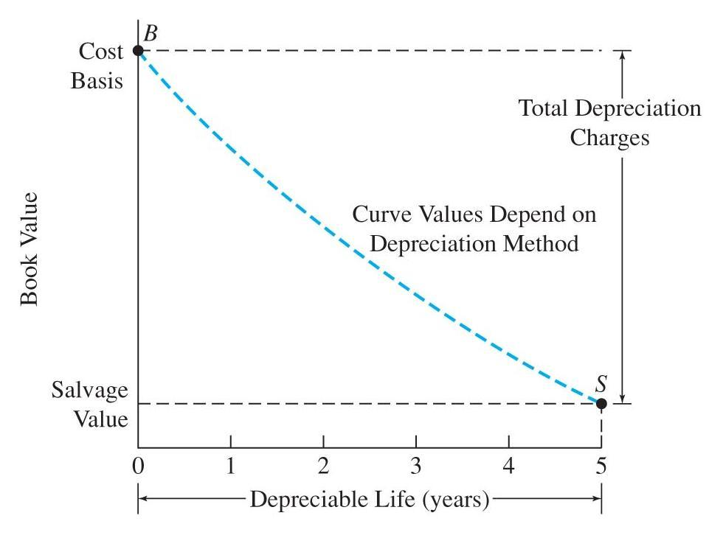
Fundamentals of Depreciation Calculation
Book Value
Book value = Cost basis – Depreciation charges made to date
Dr C.J. Willis, CAPM, P.Eng
‹#›

Slide 11
Fundamentals of Depreciation Calculation
The equation used to calculate book value of an asset over time is
BV_{t} = Cost Basis –Σ d_{i}
BV_{t} = book value of the depreciated asset at the end of time t
Cost Basis = B = dollar amount that is being depreciated. Includes the purchase price of the asset, as well as any other costs necessary to make the asset ‘ready for use’
Σ d_{i} = the sum of the depreciation deduction taken from time 0 to time t, where d_{i} is the depreciation deduction per year
t
i=1
t
i=1
Dr C.J. Willis, CAPM, P.Eng
‹#›
Notes:
Land does not lose value nor does it have a determinable useful life.
For leased property, only the owner of the property may claim depreciation expenses. (Consider leasing a car, only the owner you are leasing it from can claim depreciation expenses since the owner purchased the car as capital asset)
In depreciation calculations we need to know what is the cost basis of an asset.
‹#›

Slide 12
Depreciation Methods
The depreciation method chosen is the one that best represents the actual decline in value of the property
For taxation purposes, governments specify exactly how depreciation is to be calculated.
In Canada the method of depreciation for income tax purposes is the Capital Cost Allowance (CCA) deductions
In the US it is called the Modified Accelerated Cost Recovery System (MACRS)
Dr C.J. Willis, CAPM, P.Eng
‹#›

Slide 13
Depreciation Methods
General depreciation methods include:
Straight line method
Sum-of-year’s-digits
Declining-balance
Unit-of-production methods
Each method requires estimates of an asset’s useful life and salvage value.
Dr C.J. Willis, CAPM, P.Eng
‹#›

Slide 14
Straight Line Depreciation
Straight Line Depreciation
Annual depreciation charge = d₁=(B-S)/N
B = cost basis, S = salvage value, N = depreciable life
Straight line depreciation is often used for intangible property
Straight-Line depreciation Example
Cost of an Asset B=$900
Depreciable life, in years, N = 5
Salvage value, S = $70
Compute the straight line depreciation schedule.
Annual depreciation charge = d_{t} = B-S/N = 900-70/5=$166
Dr C.J. Willis, CAPM, P.Eng
‹#›
Notes:
This figure shows the allocation of the total depreciation charges over the asset’s depreciable life.
The curve of “asset cost basis – depreciation charges made” starts at the cost basis and declines to the salvage value.
Looked at another way, book value is the remaining unallocated cost of the asset.
In the graph, book value goes from B at time zero to S at time 5.
‹#›

Slide 15
Straight Line Depreciation
Annual depreciation charge = d_{t} = B-S/N = 900-70/5=$166
Year, t | Depreciation for year t, d_{t} | Sum of depreciation charges up to year t | Book value at the end of year t
1 | $166 | $166 | 900-166=734
2 | $166 | $332 | 900-332=568
3 | $166 | $498 | 900-498=402
4 | $166 | $664 | 900-664=236
5 | $166 | $830 | 900-830=70
Dr C.J. Willis, CAPM, P.Eng
‹#›
Notes:
The depreciable life N may be shorter than the project life n.
‹#›

Slide 16
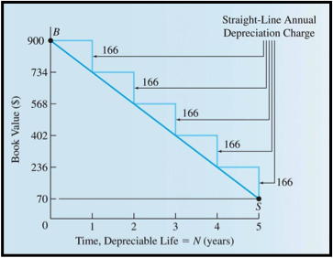
Straight Line Depreciation
Example: Straight line depreciation
Dr C.J. Willis, CAPM, P.Eng
‹#›
Notes:
This method results in larger-than-straight-line depreciation charges during an assets early years and smaller charges as the asset nears the end of its depreciable life.
Each year, the depreciation charge equals a fraction of the total amount to be depreciated (B-S)
(N-t+1) is the remaining depreciable life at the beginning of the year
(B-S) total amount depreciated
The denominator of the fraction is the sum of the year’s digits.
Example: if N=5 SOYD is 5+4+3+2+1 =15
‹#›

Slide 17
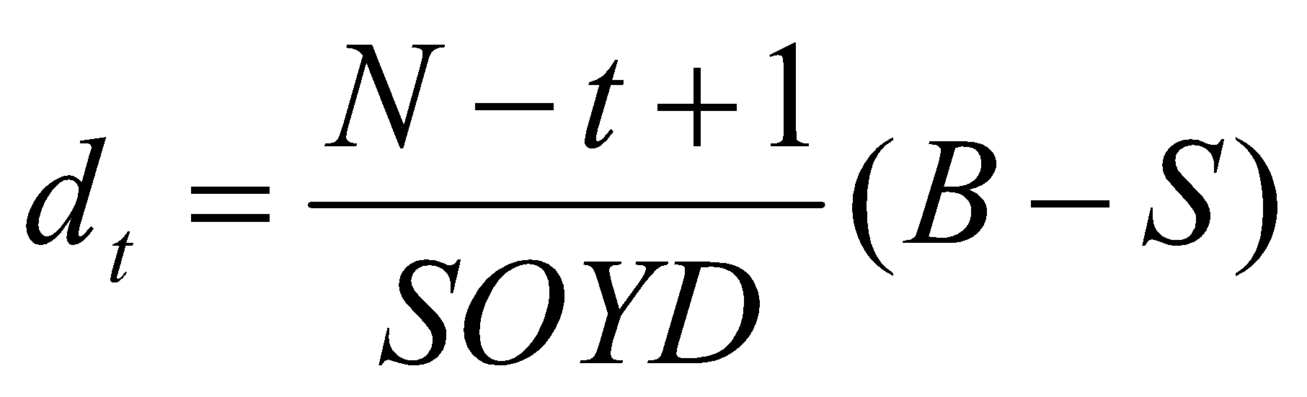
Sum-of-Years-Digits Depreciation (SOYD)
This is another method for allocating an asset’s cost minus salvage value over its depreciable life
d_{t}= depreciation charge in any year t
N = number of years in depreciable life
SOYD = sum of years’ digits,
calculated as N(N+1)/2
B = cost of the asset made ready for use
S = estimated salvage value after
depreciable life
Dr C.J. Willis, CAPM, P.Eng
‹#›
Notes:
BV_{n-1 is} the book value for the previous year
Before the days of the Capital cost allowance (CCA) and Modified accelerated cost recovery system (MACRS), companies depreciated assets over their depreciable lives at a straight line rate of 1/N or a declining balance rate of 2/N.
Thus, an asset with a ten year depreciable life would be reduced at 10% of the cost basis each year or 20% of the book value each year. Because the declining balance percentage was twice the straight-line, the method came to be known as the double declining balance (DDB)
‹#›

Slide 18
Depreciation Methods (SOYD)
Sum-of-year’s-digits example
Compute the SOYD depreciation schedule for the situation given below
Cost of the asset, B $900
Depreciable life, in years, N 5
Salvage value, S $70
Solution
SOYD = (5*6)/2 = 15
d₁= (5-1+1)/15 * (900-70) = $277
d₂= (5-2+1)/15 * (900-70) = $221
d₃= (5-3+1)/15 * (900-70) = $166
d₄= (5-4+1)/15 * (900-70) = $111
d₅= (5-5+1)/15 * (900-70) = $55
Dr C.J. Willis, CAPM, P.Eng
‹#›
Notes:
Used in situations where the recovery of depreciation on a particular asset is more closely related to use than to time.
Method is useful for machinery that processes natural resources if the resources will be exhausted before the machinery wears out.
It is not considered an acceptable method for general use in depreciating industrial equipment
‹#›

Slide 19
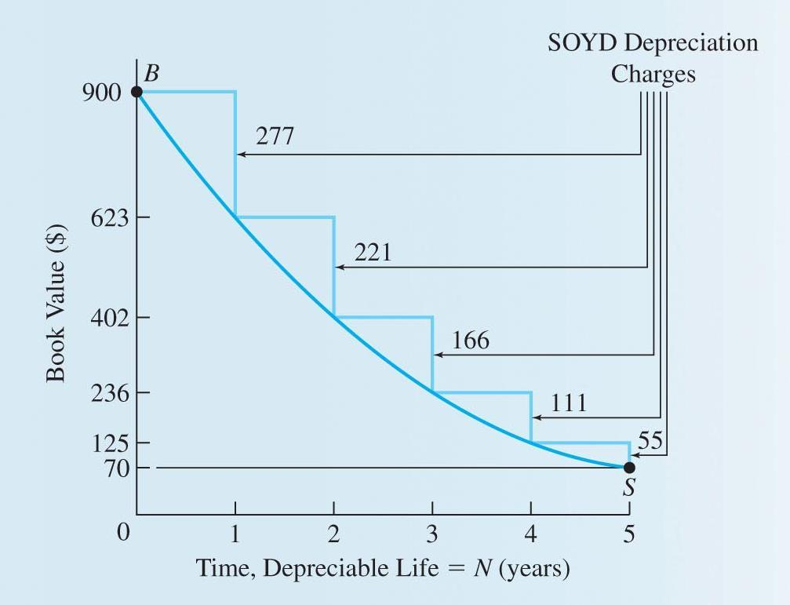
Depreciation (SOYD)
Dr C.J. Willis, CAPM, P.Eng
‹#›

Slide 20
Declining Balance
Declining Balance
applies a constant depreciation rate (D) to the declining book value of the property
Factor D is used to determine the depreciation charge for a given year such that
d_{n}=DB(1-D)^{n-1}= D * BV_{n-1}
Double Declining Balance
d_{t}=(2/N)(Book value_{t-1})
Dr C.J. Willis, CAPM, P.Eng
‹#›

Slide 21
Depreciation (Declining Balance Method)
Compute the declining balance depreciation schedule for the following situation:
Cost of asset, B = $900
Declining balance rate = 40%
Salvage value, S = $70
Year, t | Depreciation for year t, (d_{t}) | Sum of Depreciation charges up to year t | Book value at the end of year t
1 | 40% x 900 = 360 | $360 | 900-360=540
2 | 40% x 540 = 216 | 576 | 900-576=324
3 | 40% x 324 = 130 | 706 | 900-706=194
4 | 40% x 194 = 78 | 784 | 900-784=116
5 | 40% x 116 = 46 | 830 | 900-830=70
Dr C.J. Willis, CAPM, P.Eng
‹#›

Slide 22
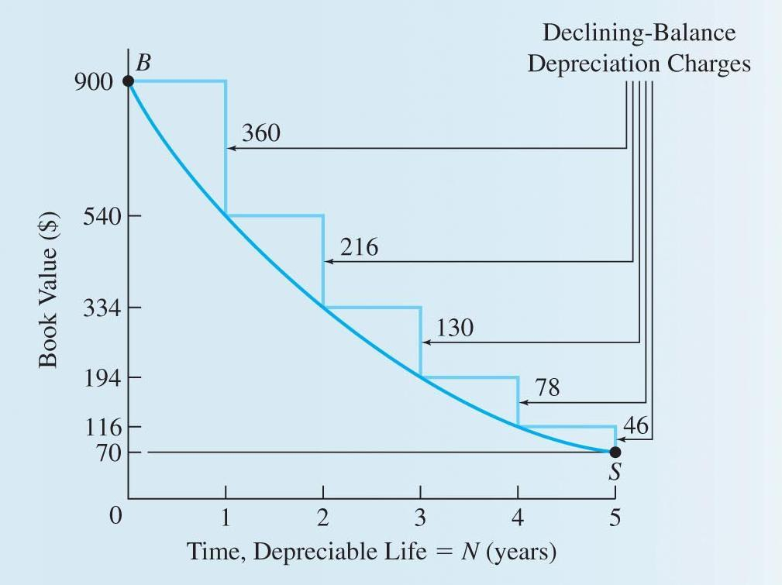
Declining Balance Method
Dr C.J. Willis, CAPM, P.Eng
‹#›

Slide 23
Unit of Production Method
Unit-of-Production Depreciation
Based on use, not time.
UOP depreciation in any year =
(Production for year / Total lifetime production) (B-S)
Method is useful for machinery that processes natural resources if the resources will be exhausted before the machinery wears out
Dr C.J. Willis, CAPM, P.Eng
‹#›

Slide 24
Unit of Production Method
Example:
A piece of equipment costing $900 has been purchased for use in a sand and gravel pit. The pit will operate for 5 years while a nearby airport is being rebuilt. Afterwards, the pit will be shut down and the equipment removed and sold for $70. Compute the unit of production depreciation schedule if the airport reconstruction schedule calls for 40,000m³ of sand and gravel as follows:
Year | Sand and Gravel Required (m³)
1 | 4000
2 | 8000
3 | 16000
4 | 8000
5 | 4000
Dr C.J. Willis, CAPM, P.Eng
‹#›

Slide 25
Unit of Production Method
Example (continued)
The cost basis B = $900
Salvage Value S = $70
Total lifetime production for the asset = 40,000m³
First year unit-of-production depreciation=
(4,000m³/40,000m³)x($900-$70) = $83
Similar calculations for the following years yield
Year | UOP Depreciation
1 | $83
2 | 166
3 | 332
4 | 166
5 | 83
 | $830
Dr C.J. Willis, CAPM, P.Eng
‹#›

Slide 26
Depreciation for Tax Purposes
In Canada, the Canada Revenue Agency (CRA) is responsible for collecting income taxes.
Canadian income tax law permits corporations to depreciate most capital assets by the declining-balance method
At a fixed rate specified in the tax legislation
Since the depreciation allowance for income tax purposes represents an allowable deduction in computing income, it is referred to as Capital Cost Allowance (CCA)
Dr C.J. Willis, CAPM, P.Eng
‹#›

Slide 27
Depreciation for Tax Purposes
The legislation is very specific about how the capital cost allowance is to be calculated.
The prescribed method is called asset-class accounting
All assets of a single class are grouped together in a single ledger
When additional assets of that class are acquired, their cost is added to that account; when assets are disposed of, the proceeds are deducted from the account
The CCA for any year is the account total at the end of the year times the capital cost allowance rate for the class
Dr C.J. Willis, CAPM, P.Eng
‹#›

Slide 28
Depreciation for Tax Purposes
The CCA rate that applies to each class is the maximum rate.
The maximum capital cost allowance that a company could take in any one year would just be sufficient to reduce the taxable income to 0
In the first year of ownership of a depreciable asset, only one half of the maximum rate can be applied. This is called the 50% rule or half-year convention
Dr C.J. Willis, CAPM, P.Eng
‹#›

Slide 29
Calculating the CCA
Capital Cost Allowance is claimed by completing the CRA form called Schedule 8
The income tax guide (Schedule II of the income tax regulations) provides a list of the most common capital cost allowance (CCA) classes
Dr C.J. Willis, CAPM, P.Eng
‹#›

Slide 30
Calculating the CCA
See Table 11.1 (corporation income tax guide) of the course text
Dr C.J. Willis, CAPM, P.Eng
‹#›
Notes:
This equation shows that year to year depreciation charges reduce and asset’s book value over its life.
‹#›

Slide 31
Calculating the CCA
See figure 11.6 of the course text (Schedule 8 from 2003 T2 Corporate income tax guide)
Dr C.J. Willis, CAPM, P.Eng
‹#›

Slide 32
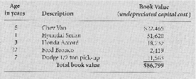
CCA Example (Example 11-6, pp 380)
A firm has 6 vehicles; the make, age and current book value of each is as follows:
What depreciation deduction (CCA) is permitted at the end of the current year (year 1)?
Dr C.J. Willis, CAPM, P.Eng
‹#›

Slide 33
CCA Example (Example 11-6, pp 380)
According to the tax legislation, automotive equipment is a Class 10 asset and can be depreciated at a CCA rate of 30%. All the vehicles are grouped into a single CCA schedule as follows:
1 Class No. | 2 Undepreciated capital cost at the beginning of the year (underpreciated capital cost at the end of the year from last year’s CCA schedule) | 3 Cost of acquisitions during the year (new property must be available for use) | 5 Proceeds of dispositions during the year (amount not to exceed the capital cost) | 6 Undepreciated capital cost (Column 2 plus Column 3 plus or minus column 4 minus column 5) | 7 50% rule (1/2 of the amount, if any, by which the net cost of acquisitions exceeds Column 5) | 8 Reduced undepreciated capital cost (column 6 minus Column 7) | 9 CCA rate % | 12 Capital cost allowance (column 8 multiplied by column 9; or a lower amount) | 13 Undepreciated cost at the end of the year (column 6 minus column 12)
10 | $86,799 | $-- | $-- | $86,799 | $-- | $86799 | 30% | $26,040 | $60,759
Dr C.J. Willis, CAPM, P.Eng
‹#›

Slide 34
CCA Example (Example 11-6, pp 380)
In year 2 the company sells the Honda Accord for $20,000. What CCA is permitted at the end of year 2?
1 Class No. | 2 Undepreciated capital cost at the beginning of the year (underpreciated capital cost at the end of the year from last year’s CCA schedule) | 3 Cost of acquisitions during the year (new property must be available for use) | 5 Proceeds of dispositions during the year (amount not to exceed the capital cost) | 6 Undepreciated capital cost (Column 2 plus Column 3 plus or minus column 4 minus column 5) | 7 50% rule (1/2 of the amount, if any, by which the net cost of acquisitions exceeds Column 5) | 8 Reduced undepreciated capital cost (column 6 minus Column 7) | 9 CCA rate % | 12 Capital cost allowance (column 8 multiplied by column 9; or a lower amount) | 13 Undepreciated cost at the end of the year (column 6 minus column 12)
10 | $60,759 | $-- | $20,000 | $40,759 | $-- | $40,759 | 30% | $12,228 | $28,523
Dr C.J. Willis, CAPM, P.Eng
‹#›

Slide 35
CCA Example (Example 11-6, pp 380)
In Year 3 the company buys a Toyota Land Cruiser for $26,000. What CCA is permitted at the end of Year 3?
1 Class No. | 2 Undepreciated capital cost at the beginning of the year (underpreciated capital cost at the end of the year from last year’s CCA schedule) | 3 Cost of acquisitions during the year (new property must be available for use) | 5 Proceeds of dispositions during the year (amount not to exceed the capital cost) | 6 Undepreciated capital cost (Column 2 plus Column 3 plus or minus column 4 minus column 5) | 7 50% rule (1/2 of the amount, if any, by which the net cost of acquisitions exceeds Column 5) | 8 Reduced undepreciated capital cost (column 6 minus Column 7) | 9 CCA rate % | 12 Capital cost allowance (column 8 multiplied by column 9; or a lower amount) | 13 Undepreciated cost at the end of the year (column 6 minus column 12)
10 | $28,523 | $26,000 | $0 | $54,532 | $13,000 | $41,523 | 30% | $12,459 | $42,072
Dr C.J. Willis, CAPM, P.Eng
‹#›
Notes:
For year 2, the depreciation for the year is $166. The sum of depreciation charges up to year 2 is the sum of the charges for the previous year and year two
‹#›

Slide 36
Summary
Depreciation: Expense of an asset that is calculated over the depreciable life of the asset.
There are a number of types of depreciable assets.
There are also a number of depreciation methods.
Straight-line ; sum-of-year’s-digits, declining-balance, unit-of production
In Canada, legislation provides the rules for depreciation of assets. Called:
Capital Cost Allowance
Dr C.J. Willis, CAPM, P.Eng
‹#›

